Slide 1
Cloud computing
Pavan Kumar Chongala
Naga Tanmaiyee Nagalla
Venkata Sreesudha Madabhushi

Slide 2


Goal
To do analysis on the Autism Spectrum Disorder (ASD) data of both adults and toddlers datasets by visualizing the data with the help of most influential factors.
To deploy a website by pushing the obtained the information into a cloud tool.

Slide 3

Tools and Technologies used
Python
Bootstrap
Javascript
HTML
CSS
GoogleColab

Slide 4
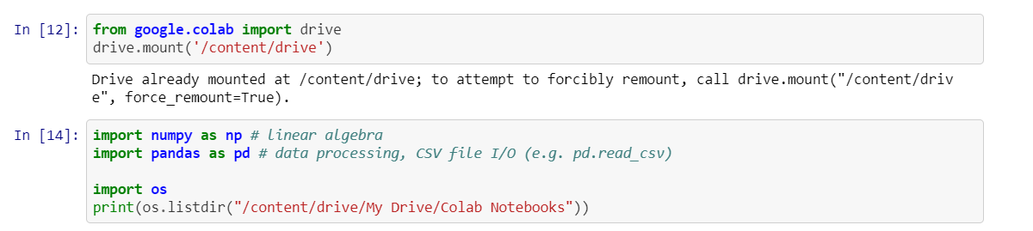
Retrieving the data

Slide 5
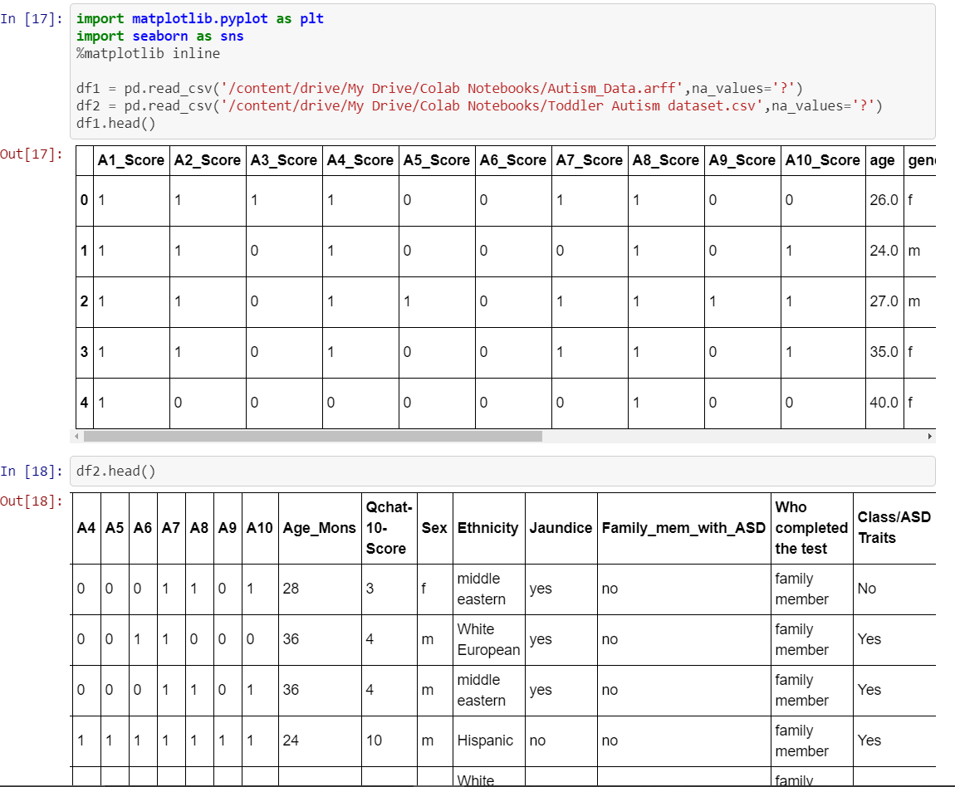
Reading and displaying the data

Slide 6
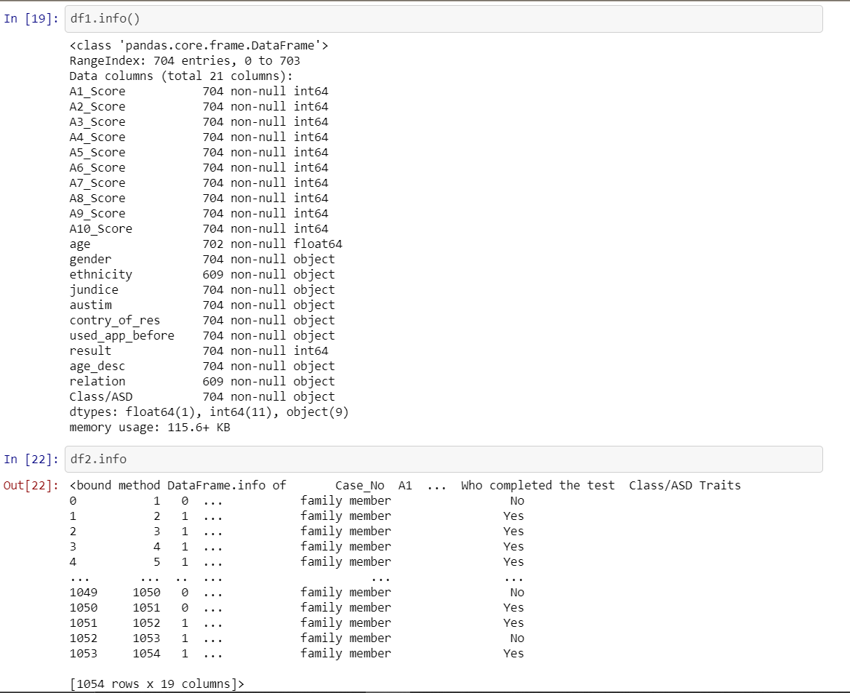
Summarizing the data

Slide 7
Visualizing the Data

Slide 8
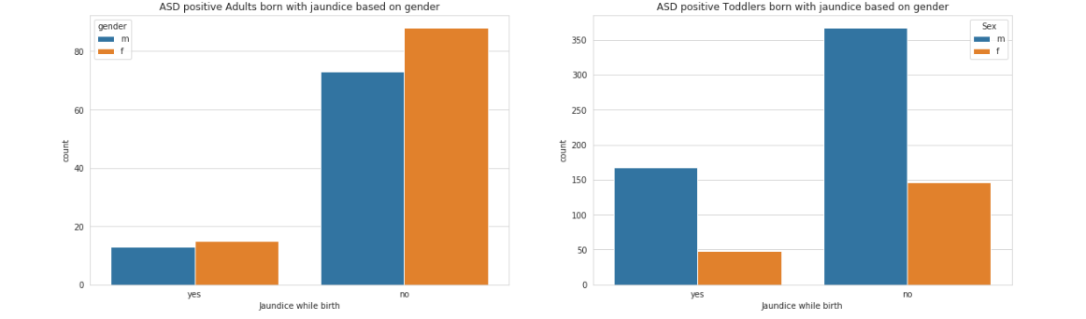
ASD Positive patients with jaundice from birth---adults and toddlers

Slide 9
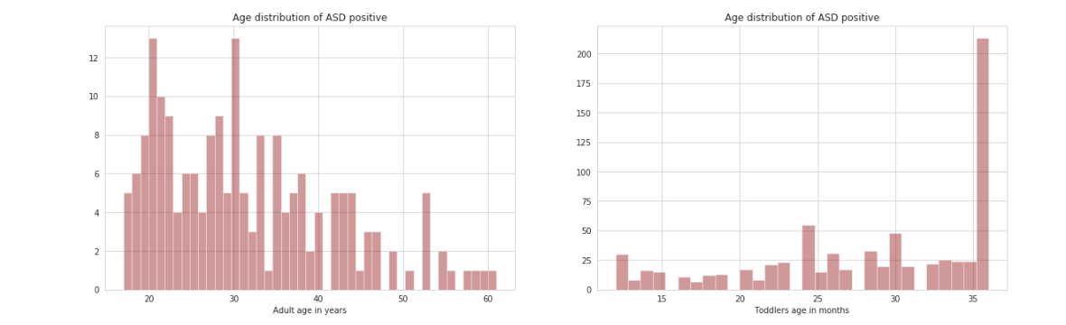
Asd positive based on age adults and toddlers

Slide 10
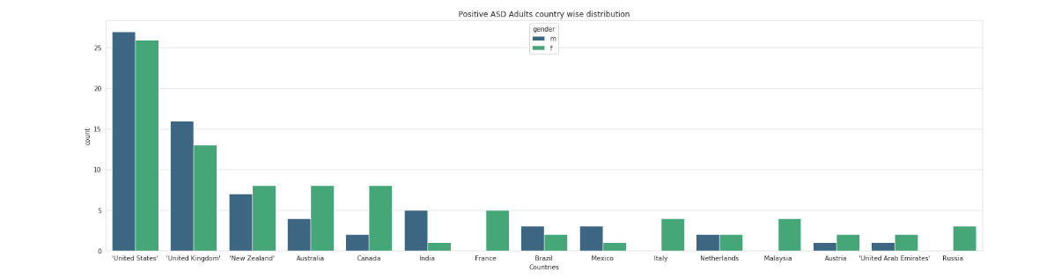
Adults : Asd positive – country wise distribution

Slide 11
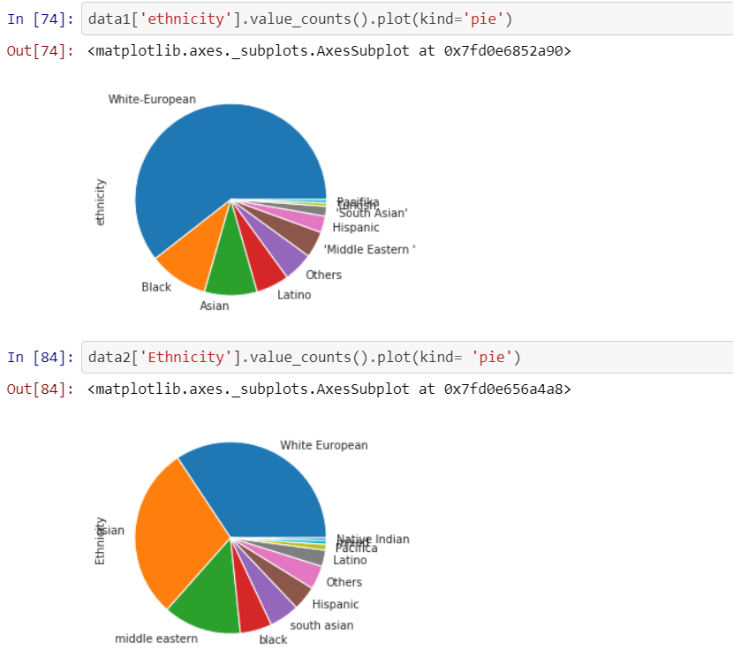
Adults matplots
Plots based on ethnicity for both male and female

Slide 12
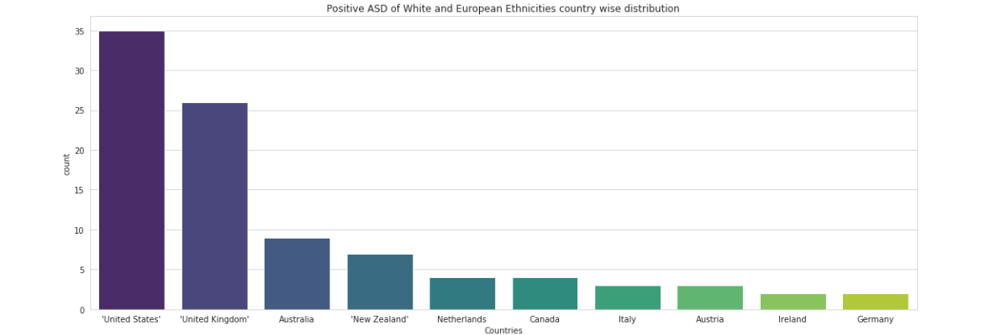
Adults : ASD positive patients of white and European ethnicities

Slide 13
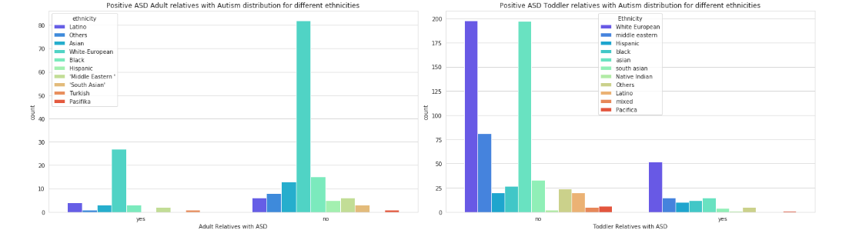
Distribution of autism in family within different ethnicity

Slide 14
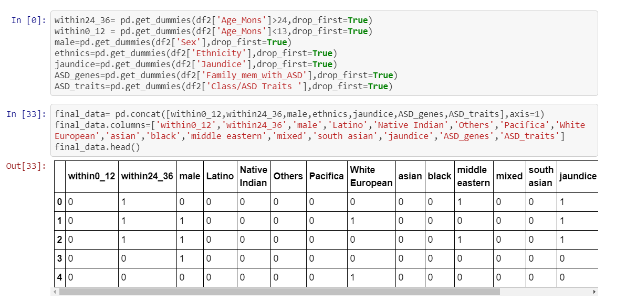
Concatenating the data

Slide 15
statistical analysis on toddlers dataset

Slide 16
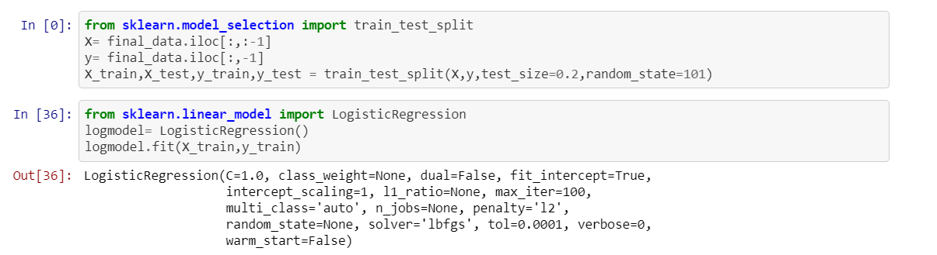
Logistic regression

Slide 17
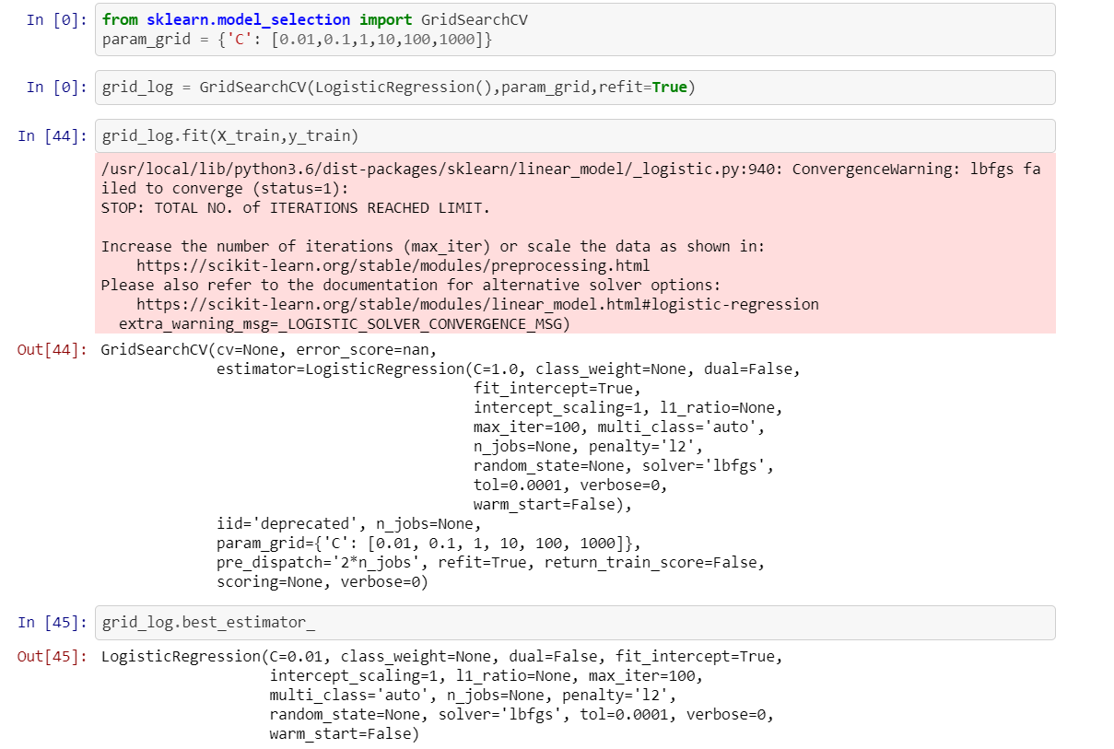

Slide 18
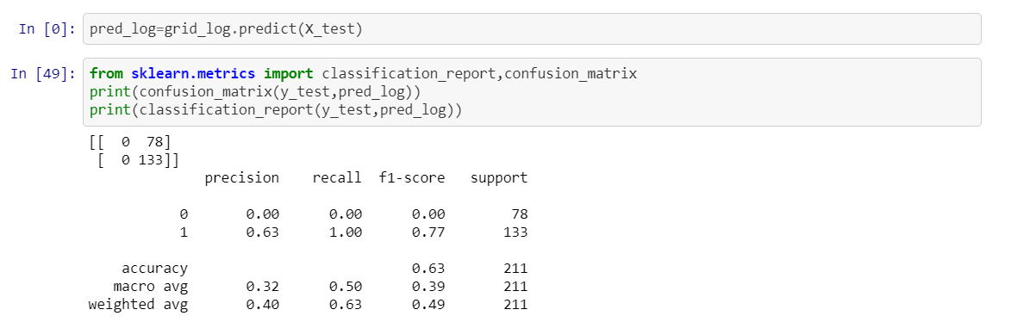

Prediction using confusion matrix

Slide 19
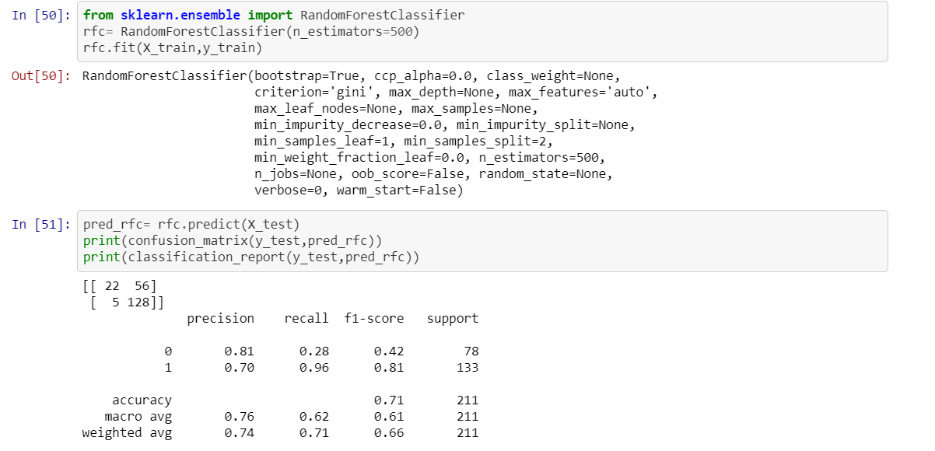
Random forest classifier

Slide 20
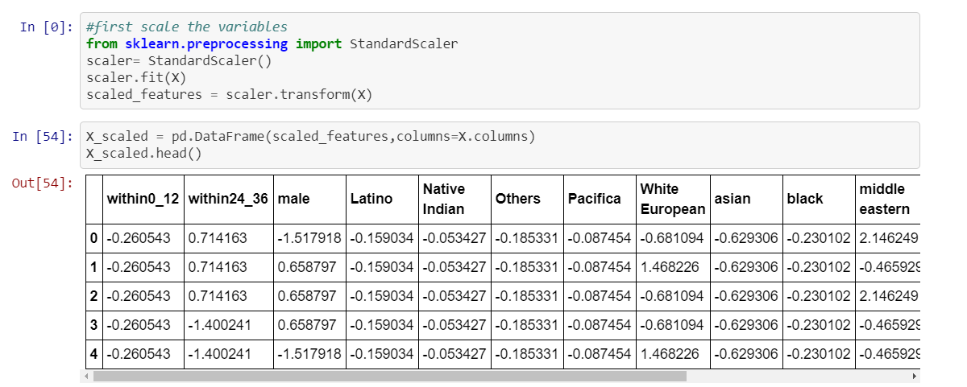
Scaling the variables

Slide 21
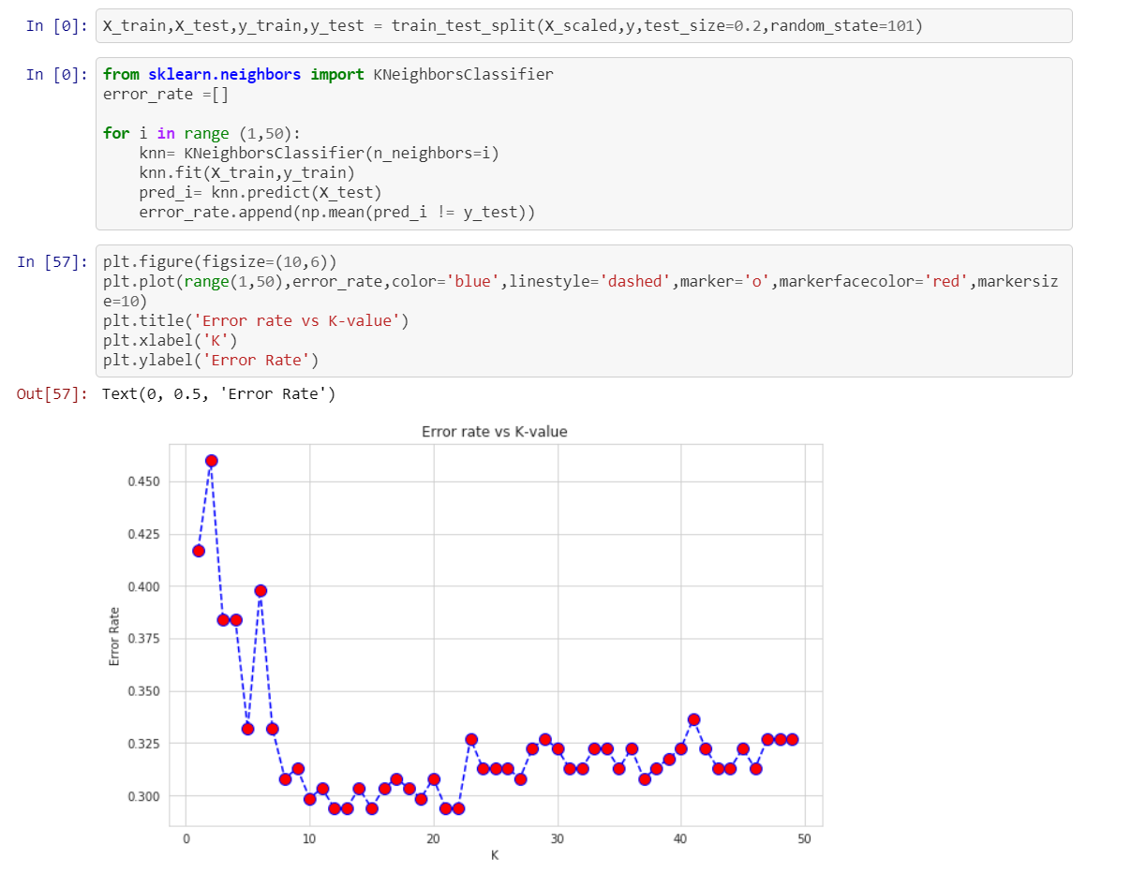
KNN classifier

Slide 22
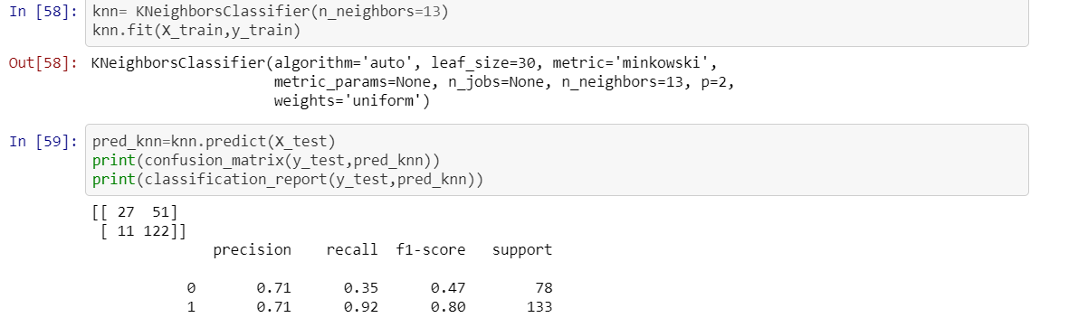
Prediction using confusion matrix

Slide 23
To do
To pull some more interesting visualizations from both the adults and toddlers datasets based on the ethnicity and gender.
Prediction on adult ASD dataset.
Deployment of data into cloud(AWS or Azure).
Visualizing the dynamic data on the created website.

Slide 24
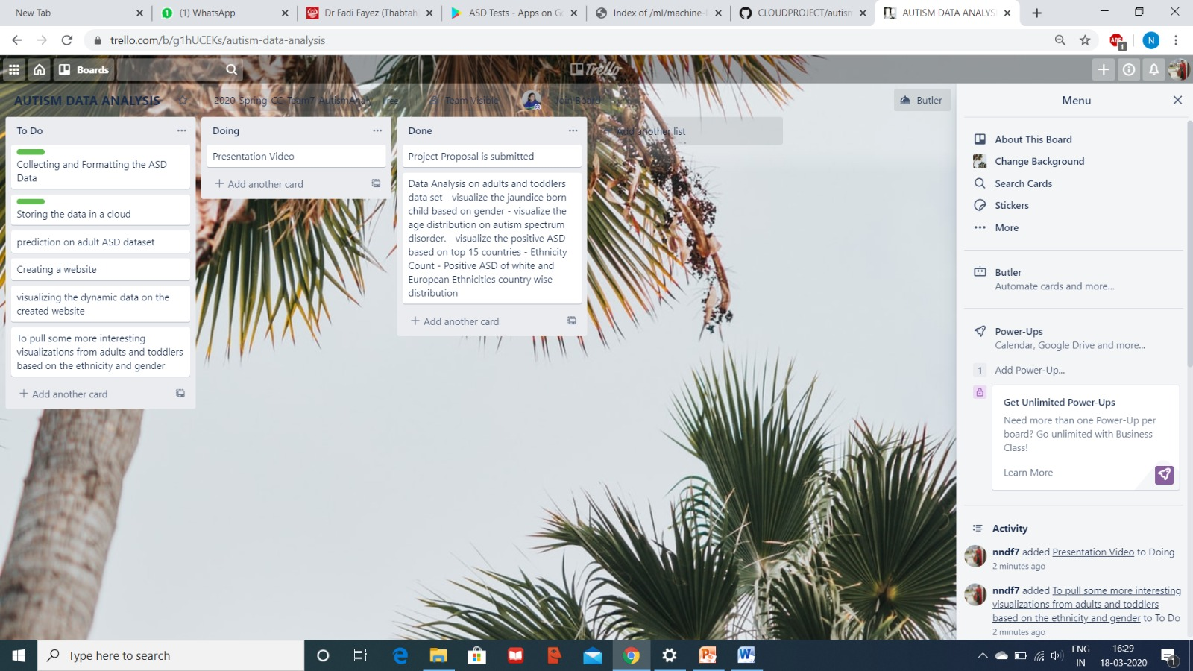
Trello updates screenshot

Slide 25
GitHub link
https://github.com/Sreesudham/CLOUDPROJECT/blob/master/autismprediction.ipynb

Slide 26

Thank you

